Slide 1
Magic Item Creator
Team 6: Ian Kaiserman, Ian Burgess, Neriah Graham, Evan Rohde

Slide 2
Item Traits
Items can be associated with traits
Existing traits can be easily added to new items
Represented by strings

Slide 3
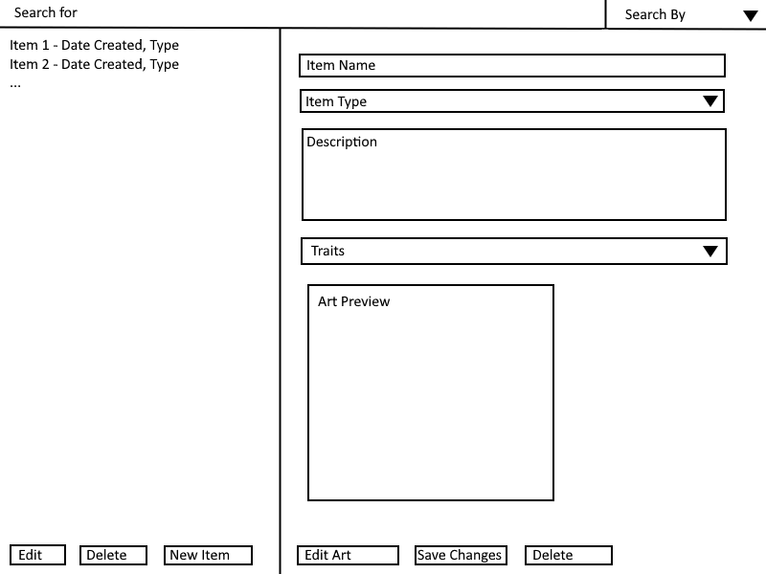

Slide 4
GUI
GUI hooked up with Magic Item Object
Layout work still in progress

Slide 5
Art Editor
Pixels as Tiles
Place Tiles Through Clicking
May limit colors

Slide 6
PDF Creation
PDFHelper class implemented into base project
Tested with a MagicItem object - success
Converted project to a Maven project for use of dependencies (required) - success
Need to organize overall project for future proofing work with other dependencies

Slide 7
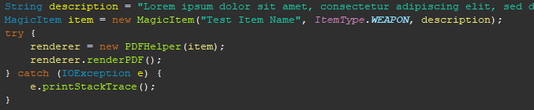



PDF creation code snippets

Slide 8
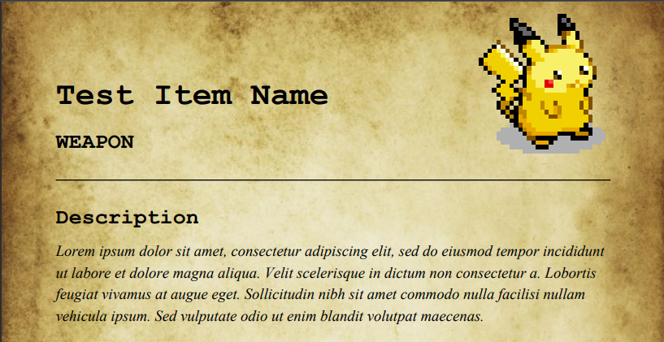
Example PDF after implementing MagicItem object information

